Slide 1



EMPLOYEES’ SOCIAL SECURITY (AMENDMENT) ACT 2026:
NON-EMPLOYMENT INJURY SCHEME (SKBBK)
“LINDUNG 24 JAM”
PERTUBUHAN KESELAMATAN SOSIAL
Ver. 1.0/SKBBK/JUN26

Slide 2

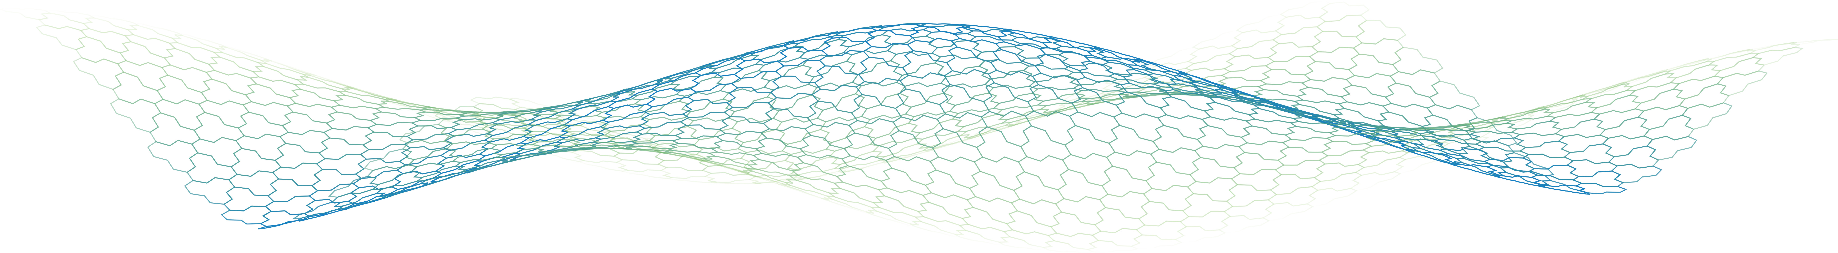
CONTENTS
1.
Introduction
05
2.
Protection & Coverage
08
3.
Benefits
10
4.
Contributions & Contribution Process
15
5.
Employers' Responsibilities
27

Slide 3
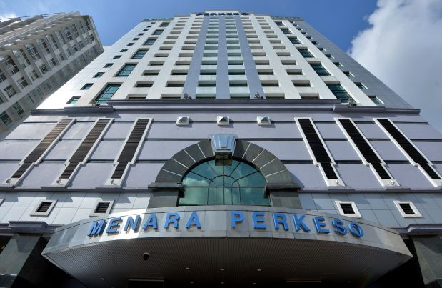
OBJECTIVES
Introduction to the Non-Employment Injury Scheme (LINDUNG 24 Jam)
Explaining the legal framework under the amended Act
Informing employers about their roles in the contribution proces
Assisting employers in their preparations for the implementation of the LINDUNG 24 Jam Scheme
3

Slide 4
INTRODUCTION
LINDUNG 24 JAM SCHEME

Slide 5

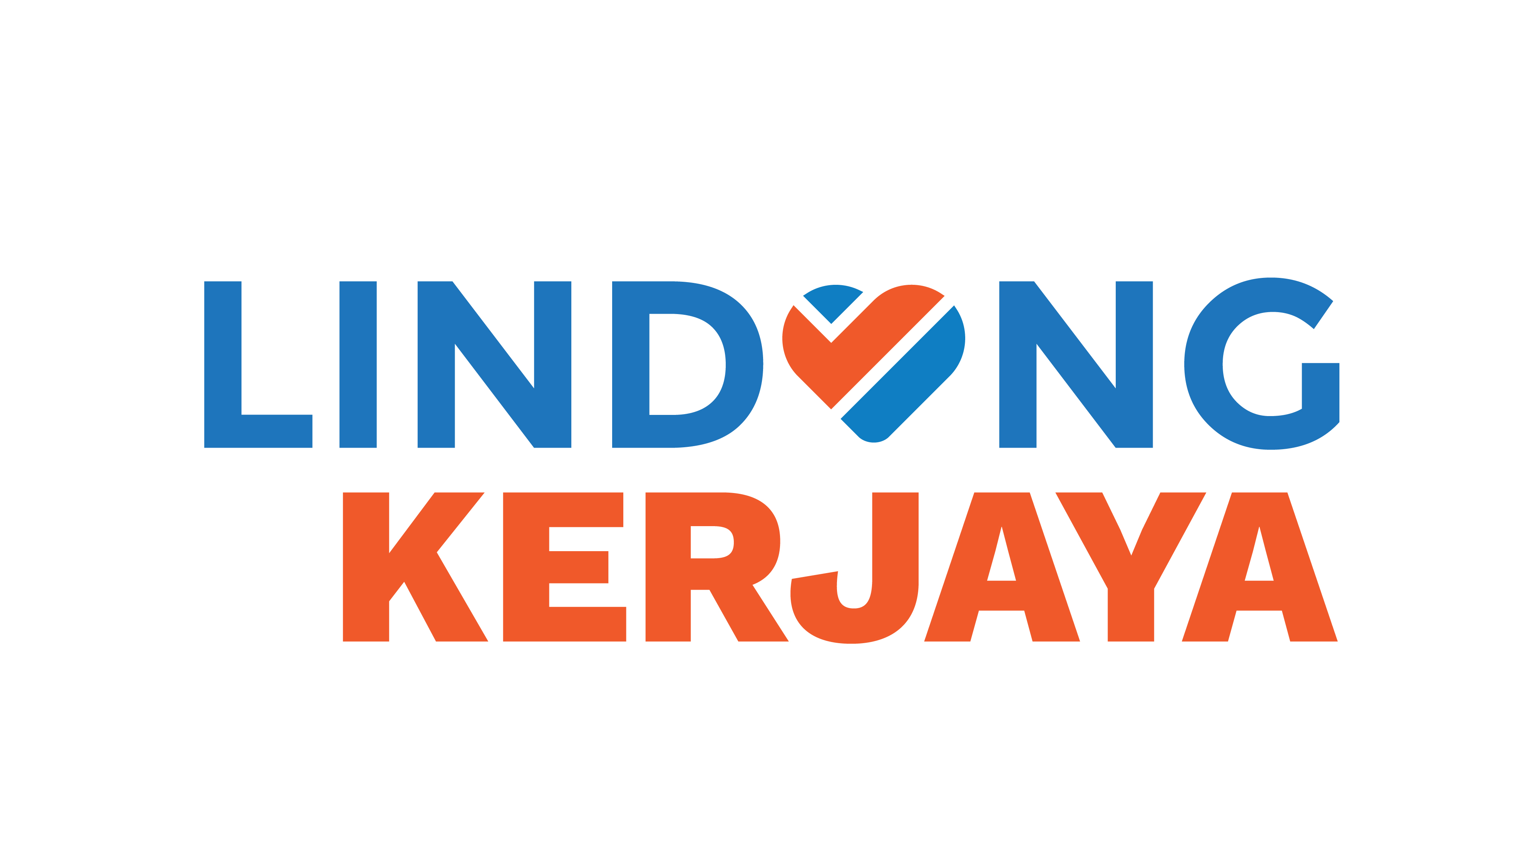

INTRODUCTION
Acts Administred and Enforced by PERKESO
Employees’ Social Security Act 1969 [Act 4]
Employment Injury Scheme
Invalidity Scheme
Self-Employment Social Security Act 2017 [Act 789]
Self-Employment Social Security Scheme
Employment Insurance System Act 2017 [Act 800]
Employment Insurance System
Housewives’ Social Security Act 2022 [Act 838]
Domestic Injury Scheme
Invalidity Scheme
Non-Employment Injury Scheme (LINDUNG 24 Jam)
5

Slide 6
INTRODUCTION
LINDUNG 24 Jam Scheme
Expand protection coverage for employees in Malaysia.
Reduce rejection of non-employment injury claims.
Provide financial support to employees and their families.
Strengthen the nation's social safety net.
Policy Objectives
The Non-Employment Injury Scheme (LINDUNG 24 Jam) is a new scheme under LINDUNG Pekerja [Act 4] that provides employees with 24-hour protection, 7 days a week, against accidents that are not related to their employment. The scheme also:
Complements the existing Employment Injury Scheme.
Extends employee protection beyond the workplace.
Strengthens the national social protection framework.
Introduced through amendments of the Employees' Social Security Act 1969 [Act 4].
Introduces protection for non-employment injuries.
Sets out the contribution mechanism for the Non-Employment Injury Scheme (LINDUNG 24 Jam).
Employers are responsible for administering the contribution process.
Legal Framework
LINDUNG 24 Jam Principles
Provides employees with 24-hour protection.
Protects employees against the risk of accidents occurring outside the course of employment.
Reduces financial burden resulting from accidents.
Strengthens the national social security system.

Slide 7



RATIONALE
LINDUNG 24 Jam Scheme
638,060 accident cases reported. 6,464 fatalities recorded.
Source: Royal Malaysia Police, 2024
Only 42%
of the nation’s working population has personal accident insurance or takaful coverage
Source: BNM Financial Sector Blueprint 2022-2026
80,452 accident cases reported, 1,045 fatalities recorded.
27,172 cases and 112 fatalities have been classified as non-employment injury since 2018.
Source: PERKESO, 2024

Slide 8

PROTECTION & COVERAGE
LINDUNG 24 Jam Scheme
Accidents that do not arise out of and in the course of employment and are not directly related to the employees’ work.
Accidents occurring within Malaysia outside working hours, including commuting accidents that are not related to employment.
Provides 24-hour protection to all eligible employees throughout their period of employment.
Employees covered under Act 4 include:
Local employees
Foreign employees
Employees across various employment sectors
Protection continues as long as the employee remains in employment.
Protections
LINDUNG 24 Jam Coverage
Examples of Covered Incidents:
Accidents at home
Road accidents outside work-related travel
Injuries sustained during personal activities
Other incidents unrelated to employment

Slide 9
BENEFITS
LINDUNG 24 JAM SCHEME

Slide 10

BENEFITS
LINDUNG 24 Jam Scheme
Constant-attendance
Allowance
Medical Benefit
Temporary Disablement
Benefit
Funeral Benefit
Permanent Disablement
Benefit
Physical or Vocational
Rehabilitation
Dependants’s Benefit
Education Benefit

Slide 11


BENEFITS
LINDUNG 24 Jam Scheme
Bil. | Jenis Faedah | Ringkasan
1 | Medical Benefit | Medical treatment for injuries resulting from an eligible accident, including treatment at PERKESO panel clinics or government clinics/hospitals.
2 | Temporary Disablement Benefit | Payable to employee throughout the medical leave period certified by a doctor, for a period of not less than 4 days including the day of the accident.
3 | Permanent Disablement Benefit | Payable to employee suffers permanent disablement due to injuries, subject to assessment by the Medical Board.
4 | Constant-attendance Allowance | Payable to employee with severe permanent disablement who require constant attendance of another person, at a monthly rate of RM500.
5 | Dependants’ Benefit | Payable to dependants if an insured person dies as a result of a non-employment injury.
6 | Funeral Benefit | An amount of RM3,000 is paid to eligible next-of-kin or the party that bears the funeral expenses, subject to terms and conditions.
7 | Physical and Vocational Rehabilitation​ | Includes physical and vocational rehabilitation, prosthetic/orthotic devices, training, and return-to-work programs according to PERKESO rates and conditions
8 | Education Benefit​ | Education loan facilities for dependent children, subject to PERKESO terms and conditions

Slide 12

RATES OF BENEFITS
LINDUNG 24 Jam Scheme
Benefit Types | Phase 1 1 June 2026 until 31 May 2028 | Phase 2 1 June 2028 until 31 May 2031 | Phase 3 Starting 1 June 2031
Temporary Disablement Benefit | 48% | 64% | 80%
Temporary Disablement Benefit and Dependants’s Benefit | 54% | 72% | 90%
Minimum Daily Rate Disablement Benefit and Dependants’s Benefit | RM18.00 | RM24.00 | RM30.00
9

Slide 13

BENEFITS TO EMPLOYEES & EMPLOYERS
LINDUNG 24 Jam Scheme
Employees receive more comprehensive protection.
Alleviating financial pressure following an accident
Supports employees’
well-being.
Strengthens employers' social responsibility

Slide 14
CONTRIBUTIONS & CONTRIBUTION PROCESS
LINDUNG 24 JAM SCHEME

Slide 15


WHO PAYS THE CONTRIBUTIONS?
LINDUNG 24 Jam Scheme
EMPLOYEES
Participation is mandatory, and contributions are fully borne by the employee.
Contributions are deducted from the employee's monthly salary.
Contribution rates range from 0.75% to 1.25%, to be introduced in phases.
EMPLOYERS
No employer contribution is required under the LINDUNG 24 Jam Scheme.
Employers are responsible for remitting contributions on behalf of employees throughout the duration of their employment.

Slide 16
PRINCIPLES & CONTRIBUTION STRUCTURE
LINDUNG 24 Jam Scheme
CONTRIBUTION PRINCIPLES
CONTRIBUTION STRUCTURE
LINDUNG 24 Jam contributions are fully borne by employees.
The new contribution structure has been introduced through amendments to the Act.
Employers are responsible for administering contributions.
Contributions are collected together with existing PERKESO contributions
Contributions are deducted through the employer's payroll system.
Managed through the existing PERKESO contribution system.
Contribution payments are made to PERKESO on monthly basis.
Integrated with the employer's payroll deduction reporting process.

Slide 17
RATES OF CONTRIBUTIONS
LINDUNG 24 Jam Scheme
Before
LINDUNG 24 Jam
After
LINDUNG 24 Jam
Share | Employment Injury Scheme | Invalidity Scheme
Employer | 1.25% | 0.50%
Employee | - | 0.50%
Share | Employment Injury Scheme | Non-Employment Injury Scheme | Invalidity Scheme
Employer | 1.25% | - | 0.50%
Employee | - | 0.75% | 0.50%
Employees’ contribution will be increased gradually:
Phase 1: (1/6/2026 – 31/5/2028) | Phase 2: (1/6/2028 – 31/5/2031) | Phase 3: (1/6/2031 onwards)
0.75% | 1.00% | 1.25%
Wage RM1,700, contribution 0.75% = RM12.35 monthly; 1.0% = RM16.50 monthly; 1.25% = RM20.60 monthly.

Slide 18
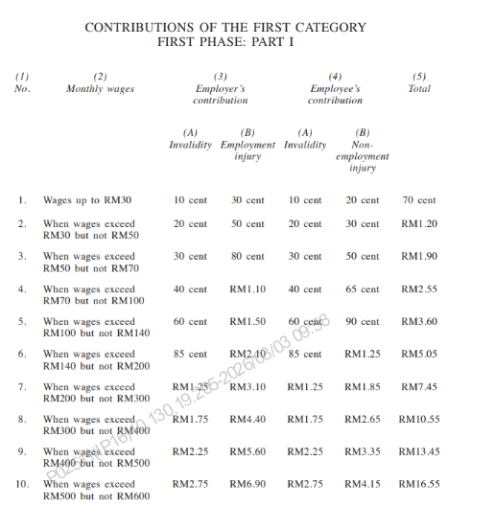
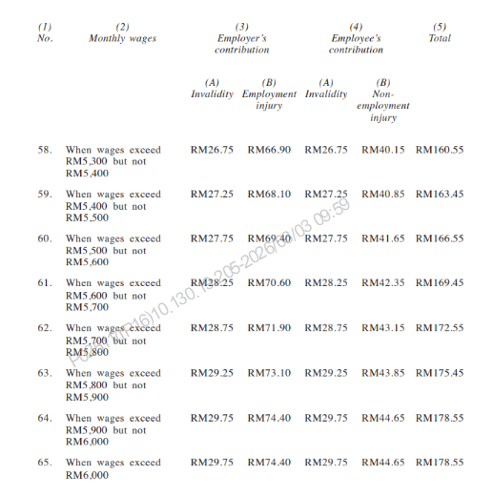
RATES OF CONTRIBUTIONS
LINDUNG 24 Jam Scheme
THIRD SCHEDULE:
RATES OF CONTRIBUTIONS

Slide 19
RATES OF CONTRIBUTIONS
LINDUNG 24 Jam Scheme
Wages | Employers’ Contribution |  | Employees’ Contribution
 | Invalidity (0.5%) | Employment Injury (1.25%) | Invalidity (0.5%) | Non-Employment Injury (Phase 1: 0.75%) | Non-Employment Injury (Phase 2: 1.00%) | Non-Employment Injury (Phase 3: 1.25%)
RM1,500 | RM7.25 | RM18.10 | RM7.25 | RM10.85 | RM14.50 | RM18.10
RM2,000 | RM9.75 | RM24.40 | RM9.75 | RM14.65 | RM19.50 | RM24.40
RM2,500 | RM12.25 | RM30.60 | RM12.25 | RM18.35 | RM24.50 | RM30.60
RM3,000 | RM14.75 | RM36.90 | RM14.75 | RM22.15 | RM29.50 | RM36.90
RM3,500 | RM17.25 | RM43.10 | RM17.25 | RM25.85 | RM34.50 | RM43.10
RM4,000 | RM19.75 | RM49.40 | RM19.75 | RM29.65 | RM39.50 | RM49.40
RM4,500 | RM22.25 | RM55.60 | RM22.25 | RM33.35 | RM44.50 | RM55.60
RM5,000 | RM24.75 | RM61.90 | RM24.75 | RM37.15 | RM49.50 | RM61.90
RM5,500 | RM27.25 | RM68.10 | RM27.25 | RM40.85 | RM54.50 | RM68.10
RM6,000 | RM29.75 | RM74.40 | RM29.75 | RM44.65 | RM59.50 | RM74.40
*Third Schedule: Rates of Contributions, Employees’ Social Security (Amendment) Act 2026

Slide 20
RATES OF CONTRIBUTIONS
LINDUNG 24 Jam Scheme
Wages | Employers’ Contribution |  |  | Employees’ Contribution
 | Invalidity (0.5%) | Employment Injury (1.25%) | Total | Invalidity (0.5%) | Non-Employment Injury (Phase 1: 0.75%) | Total | Grand Total
RM1,500 | RM7.25 | RM18.10 | RM25.35 | RM7.25 | RM10.85 | RM18.10 | RM43.45
RM2,000 | RM9.75 | RM24.40 | RM34.15 | RM9.75 | RM14.65 | RM24.40 | RM58.55
RM2,500 | RM12.25 | RM30.60 | RM42.85 | RM12.25 | RM18.35 | RM30.60 | RM73.45
RM3,000 | RM14.75 | RM36.90 | RM51.65 | RM14.75 | RM22.15 | RM36.90 | RM88.55
RM3,500 | RM17.25 | RM43.10 | RM60.35 | RM17.25 | RM25.85 | RM43.10 | RM103.45
RM4,000 | RM19.75 | RM49.40 | RM69.15 | RM19.75 | RM29.65 | RM49.40 | RM118.55
RM4,500 | RM22.25 | RM55.60 | RM77.85 | RM22.25 | RM33.35 | RM55.60 | RM133.45
RM5,000 | RM24.75 | RM61.90 | RM86.65 | RM24.75 | RM37.15 | RM61.90 | RM148.55
RM5,500 | RM27.25 | RM68.10 | RM95.35 | RM27.25 | RM40.85 | RM68.10 | RM163.45
RM6,000 | RM29.75 | RM74.40 | RM104.15 | RM29.75 | RM44.65 | RM74.40 | RM178.55
*Third Schedule: Rates of Contributions, Employees’ Social Security (Amendment) Act 2026

Slide 21

CONTRIBUTION PROCESS FLOW
LINDUNG 24 Jam Scheme
Employers record employees' wages
The payroll system calculates the LINDUNG 24 Jam Scheme
contributions
Employers deduct the contributions from employees' salary
Employers submit the contribution details and make payment to PERKESO

Slide 22
CONTRIBUTION PROCESS
LINDUNG 24 Jam Scheme
WAGE DEDUCTION
SUBMISSION OF CONTRIBUTION DETAILS TO PERKESO
Employers must ensure:
Accurate contribution calculations
Correct payroll deductions
Complete payroll records
Timely submission of contribution information
Contributions are submitted through:
ASSIST Portal by PERKESO
Employer's monthly contribution report
Integration with the existing PERKESO contribution system

Slide 23
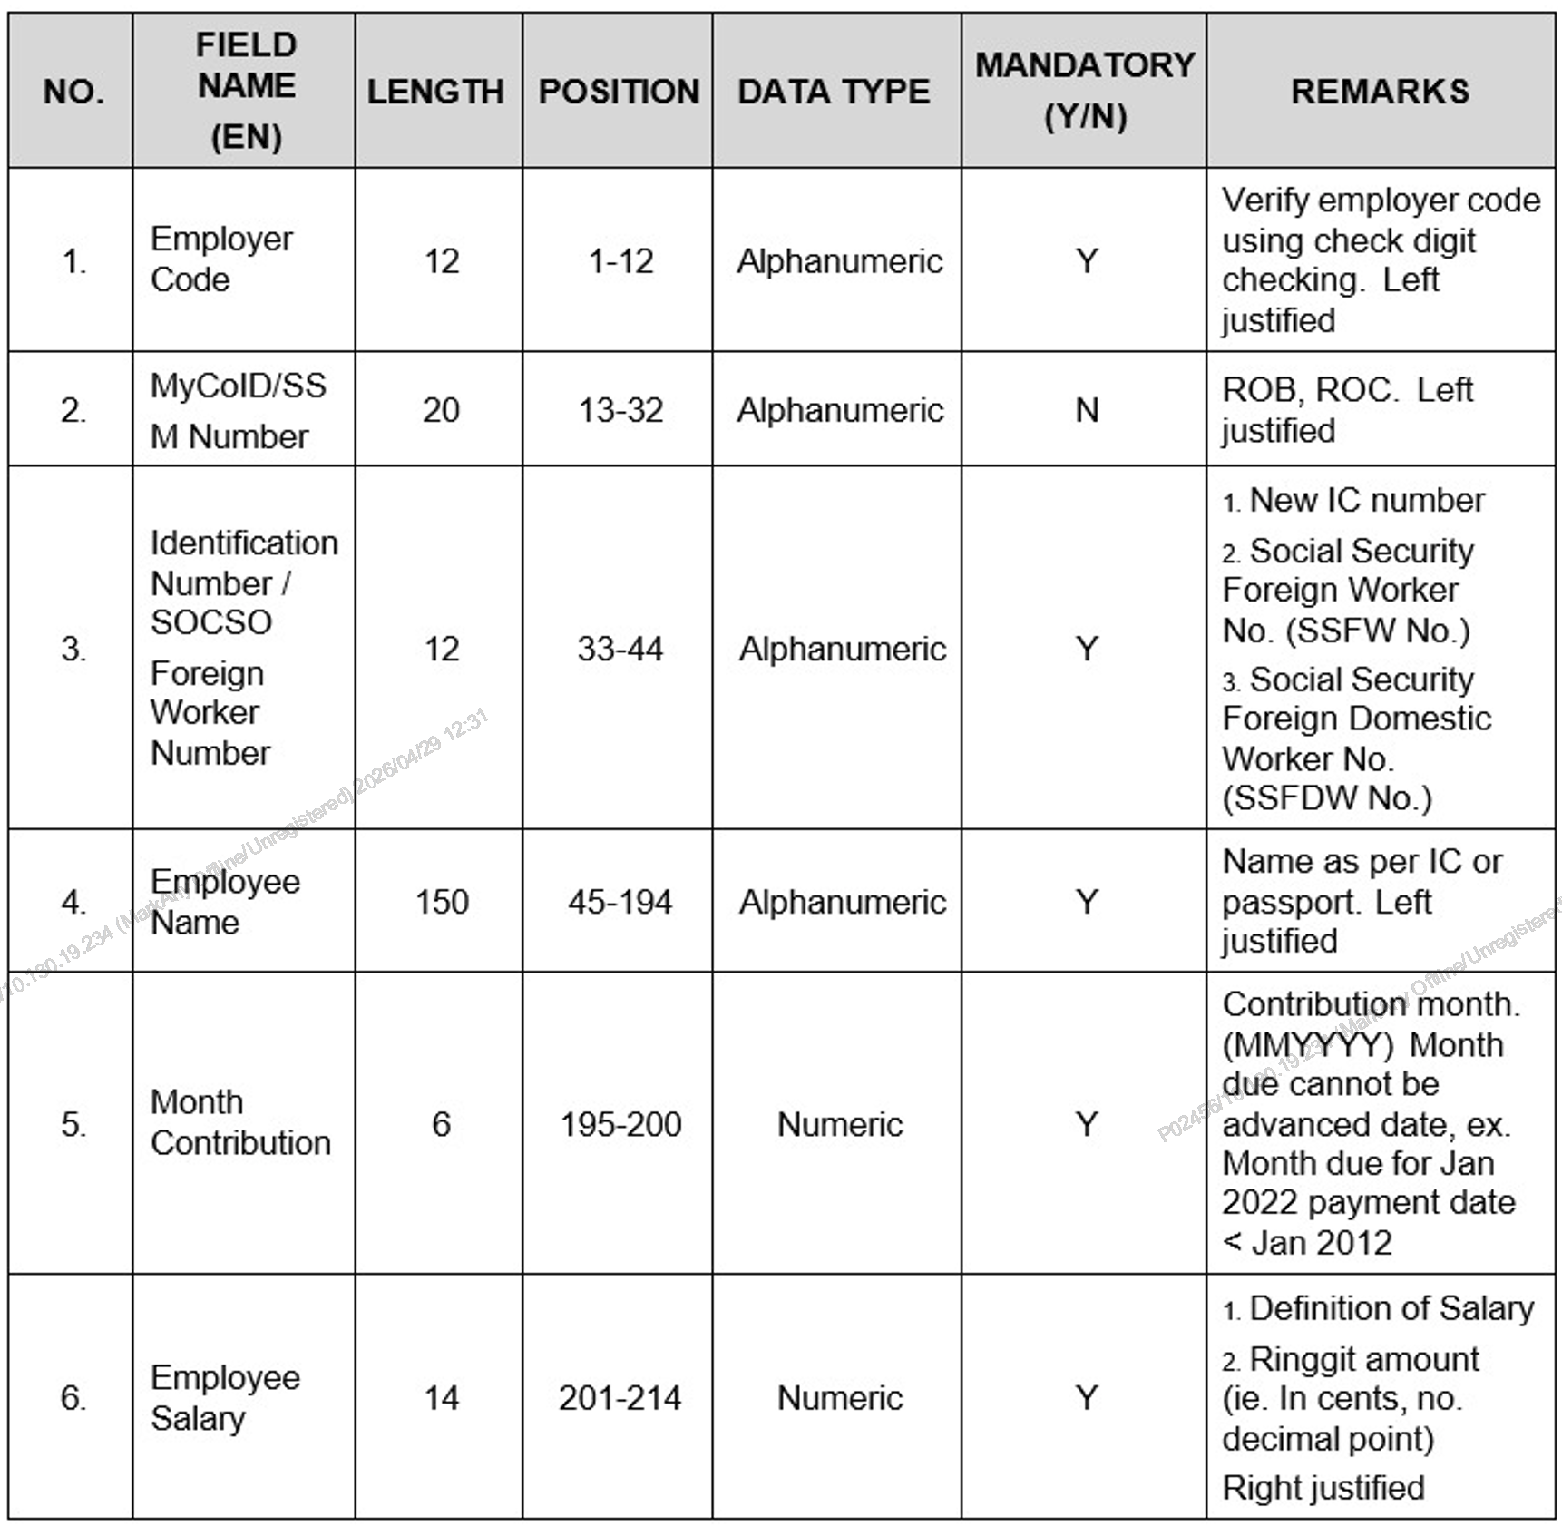
TEXT FILE FORMAT SPECIFICATIONS
PERKESO & EIS
Click here for
Text File Format Specifications

Slide 24
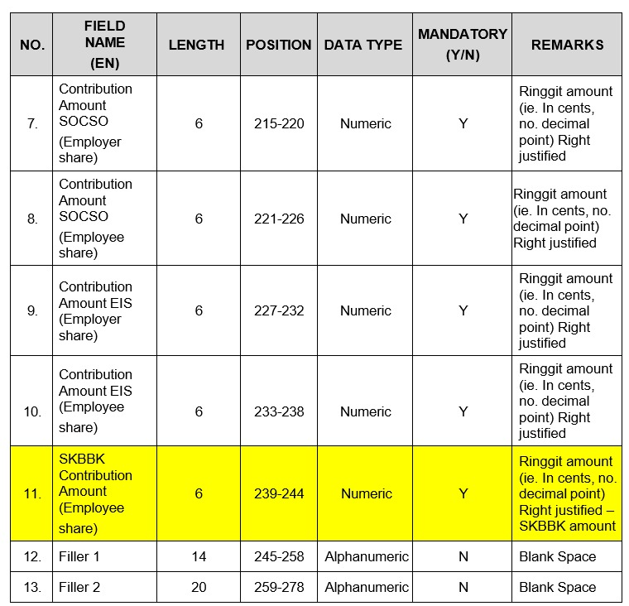
TEXT FILE FORMAT SPECIFICATIONS
PERKESO & EIS
Click here for
Text File Format Specifications

Slide 25
SAMPLE TEXT FILE

Slide 26
EMPLOYERS' RESPONSIBILITIES
LINDUNG 24 Jam SCHEME

Slide 27

EMPLOYERS' RESPONSIBILITIES
01
Register employees with PERKESO
02​
Ensure correct contribution deductions
03​
Ensure contributions are remitted promptly
04
Submit contribution details and contribution payments to PERKESO
05
Keep records of contributions and salaries

Slide 28



ENFORCEMENT ACTIONS FOR NON-COMPLIANCE
Failure to comply
may result in:
Penalties for late payment
Enforcement action under the Employees' Social Security Act 1969 [Act 4]
Legal and administrative consequences

Slide 29


IMPORTANT MESSAGES FOR EMPLOYERS
LINDUNG 24 Jam Scheme extends employee protections beyond the workplace.
Contributions are managed through the existing payroll system.
Employers play a key administrative role.
Compliance ensures employee protections.
EFFECTIVE DATE
  1 JUNE
  2026

Slide 30

Thank you

